Slide 1
JEPPIAAR INSTITUTE OF TECHNOLOGY
“Self-Belief | Self Discipline | Self Respect”
Department of Computer Science and Engineering
Subject Name : MOBILE COMPUTING Presentation Title : MULTICARRIER MODULATION
Team Members: Register number:
1.ARUN KUMAR.S 210617104005
2.BALAJI.S 210617104008
3.LINGESH A.J 210617104026
4.JANARDH.K 210617104022
5.PUSHPARAJ.K 210617104043
6.SHIDEN DAVID 21061710404

Slide 7
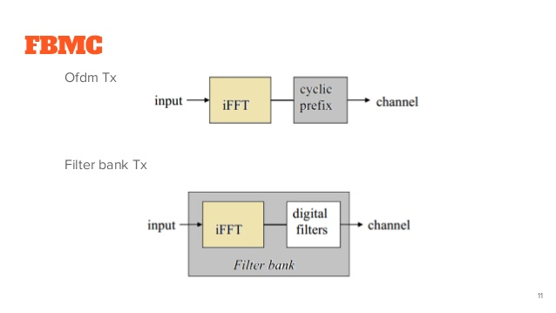

Slide 8
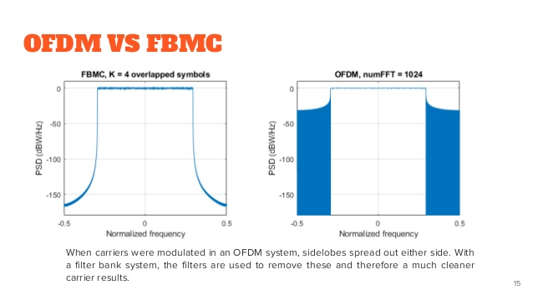

Slide 11
Future Scope
Multi carrier Modulation will be used in latest techologies

Slide 12
Reference
Wikipedia
Satellite world
Slideshare

